Slide 1

Research question
Main question:
Can we, by using historic data of financial ratios and stock prices, train a model that is able at project a stock’s future movement (up/down)?
Additional questions:
Which ratios are the most relevant?
For which time horizon can the best prediction be made?
Does adding additional features increase performance?
Introduction to Machine Learning
By
Jacob Christensen
Nicolas Loosli
Amira Sakr
Maximilian Tornow

Slide 2
Problems
Logical problems
Were to derive the class/response from?
Coding problems
How do I get to install graphviz?
How to shift vectors?
Code not working at all
Month | … | Return (1month) | class
Jan | …. | Not available | From PRC(Feb)/PRC(Jan)-1
Feb | … | =PRC(Feb)/PRC(Jan) - 1 | From PRC(Mar)/PRC(Feb)-1
Mar | … | =PRC(Mar)/PRC(Feb) - 1 | From PRC(Apr)/PRC(Mar)-1

Slide 3

Exploratory data analysis #1
Two data-sets:
The ’initial’ data-set
Data extration and exploration
Dealing with NaN
The ’extended’ data-set
Additional features
Dow Jones IA performance
”riskfree” interest rates
past returns

Slide 4

Exploratory data analysis #2
Extended data-set for 12th months returns

Slide 5

Algorithms and set-up in Python
Machine learning
Train/test-split: size and stratify
Pipeline: CV, models and hyperparameters
Data analysis
Scores and uncertainty measures
PCA and RandomForestClassifier

Slide 6
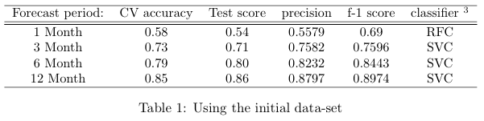
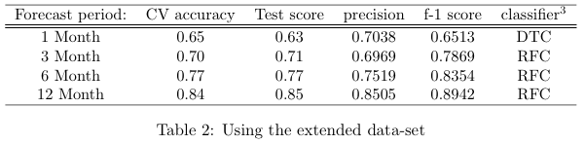

Results #1
3. Random Forest Classifier (RFC), Support Vector Classifier (SVC), Decision Tree Classifier (DTC)

Slide 7
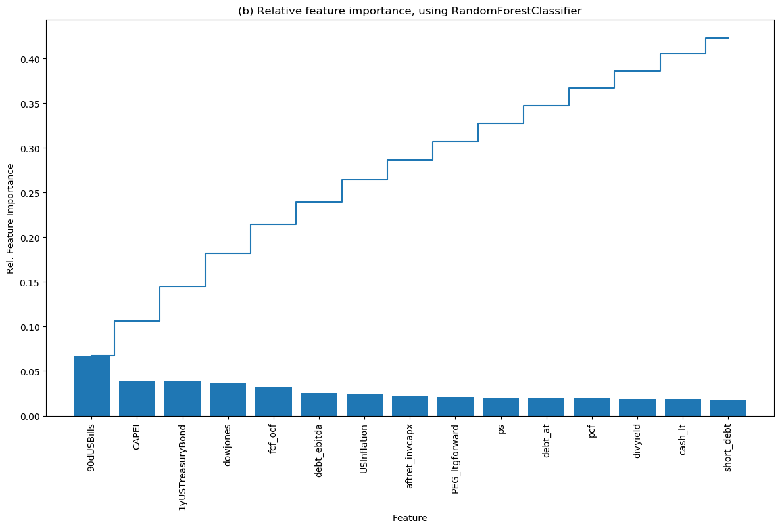

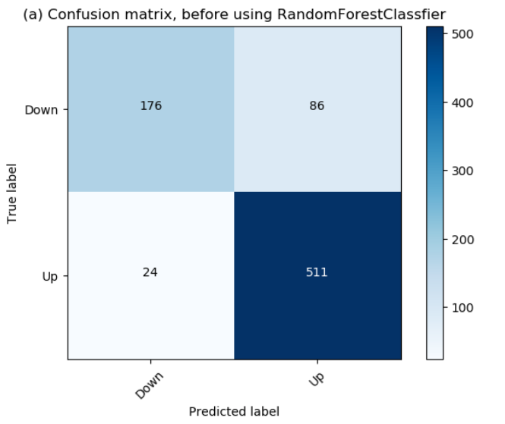
Results #2
Which is then best…?
3. Random Forest Classifier (RFC), Support Vector Classifier (SVC), Decision Tree Classifier (DTC)

Slide 8

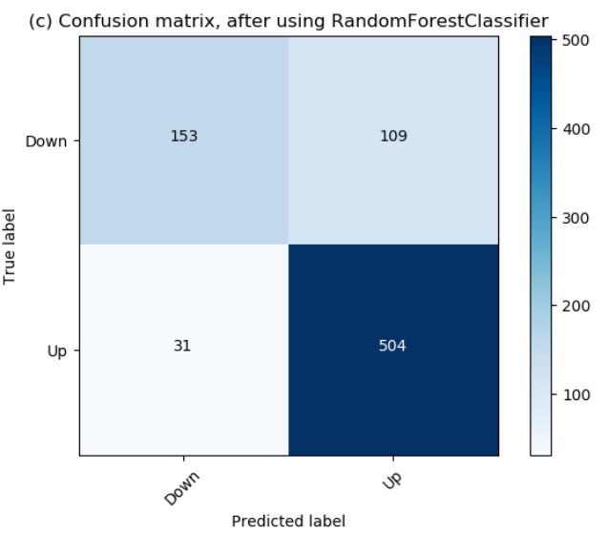
Results #3
Reduced
Extended
Extended data set
Reduced
data set
3. Random Forest Classifier (RFC), Support Vector Classifier (SVC), Decision Tree Classifier (DTC)

Slide 9

Conclusion
The more the merrier
But use feature scaling
Explanation:
Market features and companies’ fundamentals gives the best predictions when dealing in the long-run
Main question:
Can we, by using historic data of financial ratios and stock prices, train a model that is able at project a stock’s future movement (up/down)?
Additional questions:
Which ratios are the most relevant?
Which time period can be predicted best?
Does adding additional features increase performance?

Slide 10
What further could be done?
PCA feature reduction (standardized)
Check against overfitting

